Slide 1
NE 591: Advanced Reactor Materials
Fall 2021
Dr. Benjamin Beeler

Slide 2
High Temperature Gas reactors and TRISO Particles

Slide 3
High Temperature Gas Reactor
The HTGR has a long history going back to the earliest days of nuclear energy development
Commercial gas-cooled nuclear power for electricity production started in 1956 with the operation of the first 50 MWe unit at Calder Hall, UK
The design, which came to be known as Magnox, featured carbon-dioxide as the pressurized coolant and magnesium alloy cladding for the fuel
Thermal efficiency was still limited to ~ 20%. To raise thermal efficiency, later designs switched to stainless steel cladding, enriched uranium oxide fuel, higher CO2 pressures, and higher operating temperatures in what came to be known as the Advanced Gas Reactor (AGR)

Slide 4
HTGRs
The use of helium (He) as a coolant was advocated as early as 1944 in a 5 MWt experimental reactor project, also featuring an indirect gas turbine cycle
Later, the prototype DRAGON reactor was put into operation in the UK in 1965 and featured a steel pressure vessel, coated fuel particles of highly-enriched uranium-thorium carbide and a helium outlet temperature of 750ºC

Slide 5
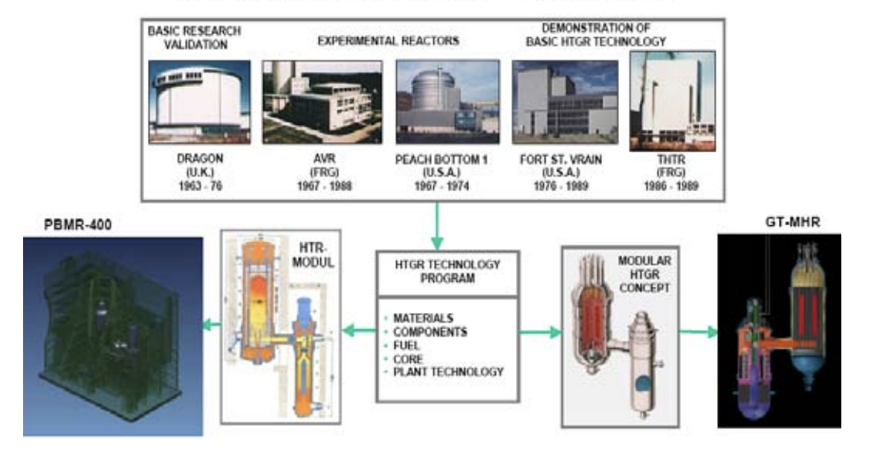
HTGRs
The substitution of He instead of air or CO2 provided excellent neutronic and thermal characteristics together with a graphite moderator
There are two mainstream HTGR design concepts; the prismatic core design and the pebble bed core design, both of which possess common advantages of the HTGR design such as inherent safety and high efficiency

Slide 6
Two types of HTGRs

Slide 7
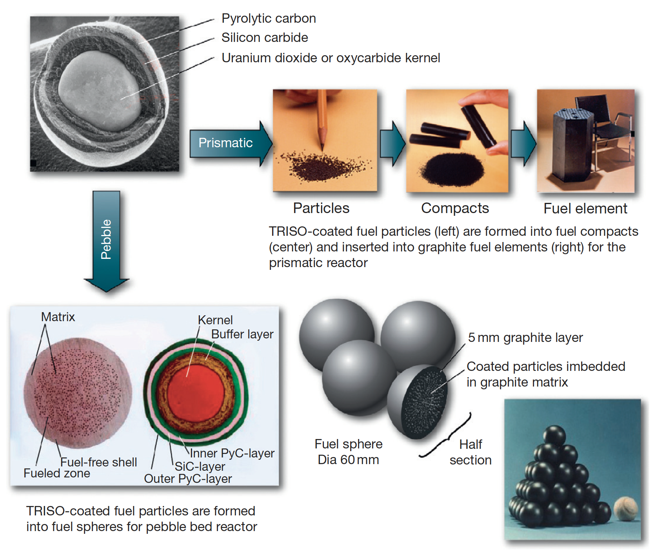

Slide 8
HTGRs
The main features of HTGRs are enhanced safety, high thermal efficiency, economical competitiveness, and proliferation resistance and these make this technology a potential candidate for the nuclear power plant deployment
One of the driving forces behind the HTGR philosophy is its utilization in the production of process heat: the high outlet gas temperatures may be utilized as a thermal heat source in endothermic chemical processes
Net thermal efficiencies greater then 45% are within the reach in some of the designs of HTGRs
The enhanced safety of the HTGR fuel is based on its coated fuel particle design consisting of uranium oxide / carbide particles coated with layers of pyrolytic carbon and silicon carbide
Coated particles are so designed that they can withstand high internal gas pressure without releasing any fission products to the environment

Slide 9
TRISO Particles
TRISO: TRistructural ISOtropic particle fuel
Layered fuel in mm-sized particles
Layers:
Fuel Kernel
Buffer
Inner Pyrolitic Carbon (IPyC)
SiC
Outer Pyrolitic Carbon (OPyC)

Slide 10
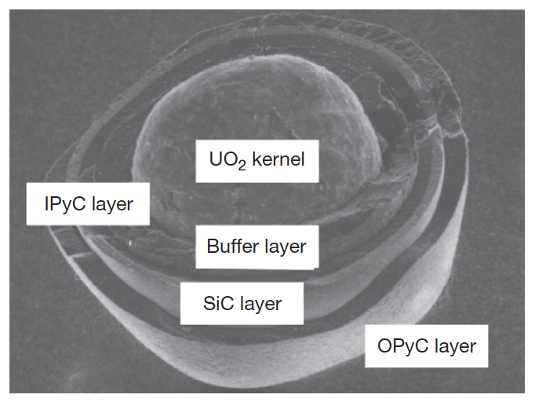
Fuel Kernel + Buffer
A variety of fissile and fertile kernels have been used in particles, including ThC2, ThO2, PuO2, (Th,U)O2, UC2, UO2, and UCO
Nominal fuel kernel diameters range between 100 and 500 mm
The fuel kernel is surrounded by a porous graphite buffer layer that absorbs fission recoils and allows space for fission gases produced during irradiation
The buffer layer is generally about 100-mm thick

Slide 11
IPyC-SiC-OPyC
Surrounding this inner buffer layer is a layer of dense pyrolytic carbon (IPyC), a silicon carbide (SiC) layer, and a dense outer pyrolytic carbon (OPyC) layer
The pyrolytic carbon layers protect the SiC layer, which is the pressure boundary
The pyrolytic carbon layers are approximately 40-mm thick; the SiC layer is usually about 35-mm thick
Each microsphere acts as a mini pressure vessel, which is designed to impart robustness to the gas reactor fuel system
TRISO diameter is typically ~750 microns

Slide 12
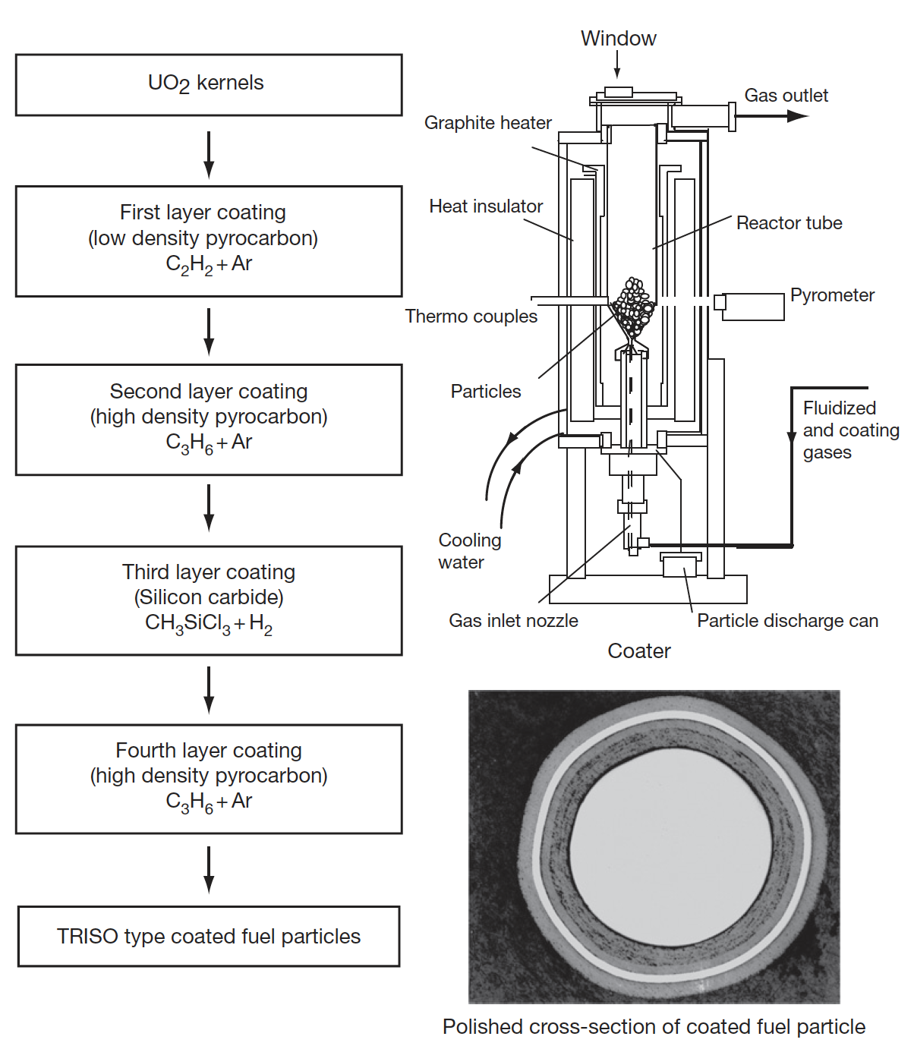
TRISO Fabrication
Rigorous control is applied at every step of the fabrication process to produce high-quality, very low-defect fuel
Defect levels are typically on the order of one defect per 100 000 particles
Specifications are placed on the diameters, thicknesses, and densities of the kernel and layers; the sphericity of the particle; the stoichiometry of the kernel; the isotropy of the carbon; and the acceptable defect levels for each layer

Slide 13
Fuel Failure Mechanisms
Overpressure:
During irradiation, fission gases are released from the kernel into the porous buffer layer. The pressure that is generated exerts tensile forces on the SiC layer of the particle
For UO2 kernels, there is also excess oxygen released during fission which will react with carbon from the buffer to form CO and CO2 gas
Particles are generally sized with a large enough buffer void volume to ensure that they do not fail by overpressure during irradiation
Particle failure is postulated to occur as a result of an insufficient or missing buffer layer that occurs during the coating process

Slide 14
Fuel Failure Mechanisms
Irradiation-induced IPyC cracking
Under irradiation, pyrocarbon (PyC) shrinks in both the radial and tangential directions
At modest fluences it begins to swell in the radial direction
This behavior puts the PyC layers into tension in the tangential direction
However, irradiation-induced creep works to relieve the tensile stress in the PyC layer
If the PyC is strongly attached to the SiC layer, the PyC shrinkage provides a strong compressive stress that offsets the tensile stresses generated by gas production in the kernel

Slide 15
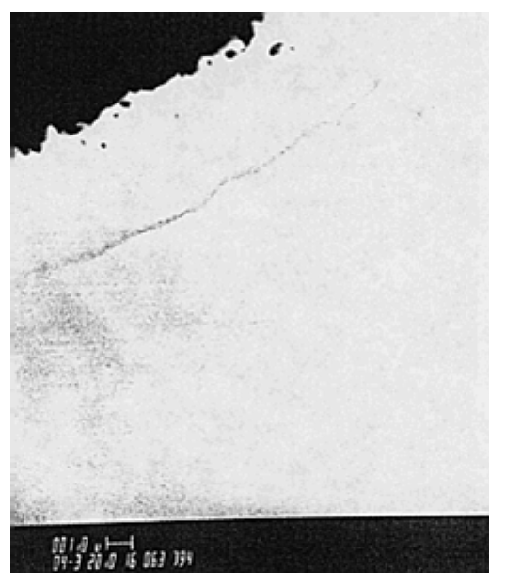
Fuel Failure Mechanisms
Debonding between IPyC and SiC
The debonding is related to the strength of the IPyC/SiC interface
Weakly bonded coating layers can partially detach because of the tensile stresses generated by the IPyC shrinkage under irradiation
A particle for which partial debonding of the IPyC from the SiC has occurred can develop relatively large tensile stresses in the SiC
Irradiation induced creep relieves the stress at longer times

Slide 16
Fuel Failure Mechanisms
Kernel migration
Kernel migration is defined simply as movement of the kernel toward the TRISO-coating, which can lead to the kernel penetrating the TRISO-coating
Kernel migration is associated with carbon transport in the particle in the presence of a temperature gradient
A thermal gradient generates different equilibrium conditions for C, UO2, CO and CO2 at either side of the particle
Carbon diffuses up the temperature gradient, the kernel diffuses down

Slide 17
Fuel Failure Mechanisms
Fission product attack
Fission products can be transported from the kernel to the inner surface of the SiC where they interact and can damage and potentially fail the SiC layer
This is more of an issue in UC kernels
In UCO kernels, the oxycarbide form of the kernel generally ties up all but the noble fission products (e.g., Pd) as either carbides or oxides, which tend to limit their mobility in the UCO system
However, Pd and Ag transport have still been observed in UCO coated particle fuel

Slide 18
Fuel Failure Mechanisms
Matrix-OPyC interactions and OPyC irradiation-induced cracking
During manufacture, infiltration of the liquid graphitic matrix into the porosity of OPyC caused mechanical weakening
During subsequent dimensional change under irradiation this caused OPyC layer to fail by cracking and debonding from the SiC layer
This has largely been addressed through specifications on the matrix material and on the microstructure of the OPyC
Non-retentive SiC
There are situations where the SiC layer becomes functionally failed or degraded in some way and is no longer retentive of fission products
Diffusive release through intact layers
If fuel temperatures during normal operation approach 1300C, then some of the fission products that are usually retained by the TRISO coating (e.g., cesium) will be able to diffuse out of the particle during normal operation
SiC degradation resulting in permeability
Cesium attack of the SiC and/or CO corrosion of the SiC can allow fission products to be released at high burnup

Slide 19
Fuel Failure Mechanisms
Creep failure of PyC
Under stress, thermal creep of the PyC will occur
In some post-irradiation heating tests,
photomicrographs reveal a thinning and failure of the PyC
Such failure has not led to failure of the SiC layer
SiC thermal decomposition
At very high temperatures (> 2000°C) the SiC layer undergoes thermal decomposition
The phenomenon is primarily a function of temperature and time and has not played a major role in fuel failure at lower accident temperatures

Slide 20
Fuel Failure Mechanisms
Kernel-coating mechanical interaction (KCMI)
At sufficiently high burn-up values, it is inevitable that all gas gaps between the kernel and coatings will close, thereby resulting in a mechanical interaction between the two
Modelling studies predict that the SiC layer will fail shortly after the onset of KCMI
This failure mechanism could be of increasing importance as attempts are made to achieve higher burn-up values

Slide 21
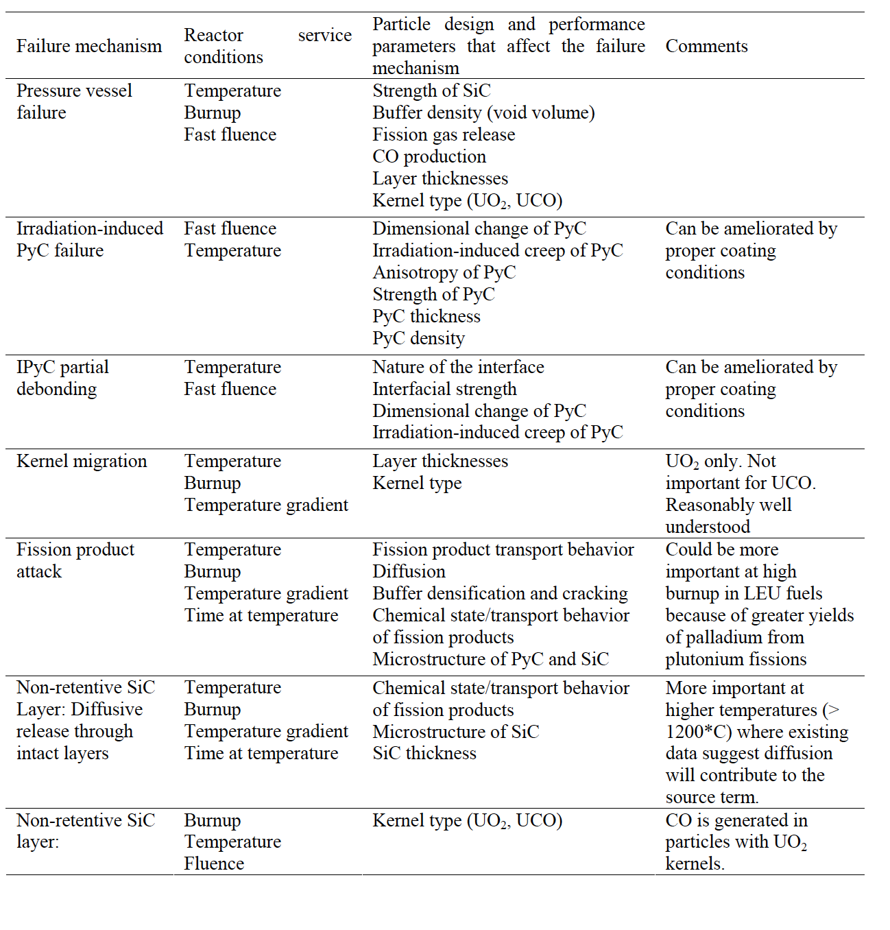
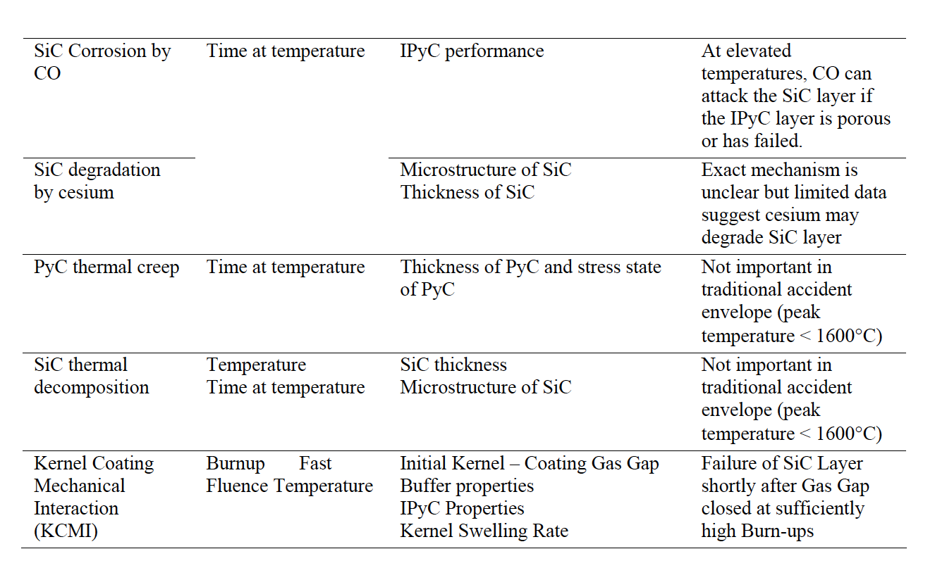
Fuel Failure Mechanisms

Slide 22
Fuel Chemistry
An important consequence of UO2 fission is the creation of free oxygen since only a part of the O2 recombines with the fission products
In the TRISO particle, an important parameter is that portion of this free oxygen which combines with carbon from the buffer/PyC coatings to form CO and CO2 gases
Identification of those compounds (solid and gaseous) that can form in fuel during normal and off-normal conditions and which elements remain in elemental form, is known as fuel chemistry
Changes in fuel chemistry may lead to many important mechanisms affecting fuel performance, e.g., kernel size (swelling), kernel migration (amoeba effect), stresses in the coatings (particle pressurization due to fission products and carbon oxide gases), thermal conductivity, creep properties modification, etc.
The oxygen potential, the pressure of oxygen in the gas phase within the fuel, is the critical parameter determining which elements in their competition for oxygen form oxides

Slide 23
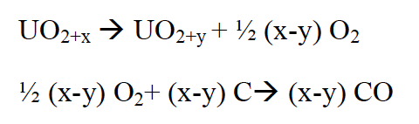
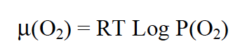
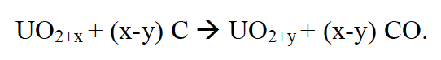
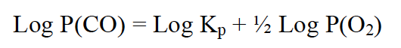
Oxygen Potential
Calculation of the oxygen potential is complex since it generally varies with distance from the particle center and with temperature, fuel burnup, fission product yields, chemical state of fission products including solid and gas phases and the effectiveness of the coating layers to absorb fission products and oxygen
The oxygen potential is represented by:
where P(O2) is the oxygen partial pressure, R is the gas constant, T is the temperature
In fresh fuel (simpler case), where we assume the fuel reaches thermodynamic equilibrium with its surrounding coatings, the main product of the reaction between UO2+x (x>0) and carbon is gaseous carbon monoxide, CO, by the following reactions:
which can be rearranged as:
Utilizing an equilibrium rate constant K,

Slide 24
Oxygen Potential
Reactions to generate CO2 are also possible, but at applicable temperatures and values of the oxygen potential, CO production dominates
What this is telling us is that as the oxygen potential, i.e. oxygen partial pressure is increased, we are generating more CO
The result of CO formation is internal pressurization of the particle which may lead, in extreme conditions, to particle failure
To limit this pressurization other fuel kernel concepts have been and are being studied, of particular interest is the oxycarbide fuel (or UCO) comprising a mixture of UC2 and UO2
Gas formation is effectively reduced within the UCO particle as compared to a UO2 particle due primarily to their lower oxygen inventory
Additionally, there is a gettering effect of the UC2 on the oxygen released during UO2 fission which forms a condensed oxide rather than CO gas

Slide 25
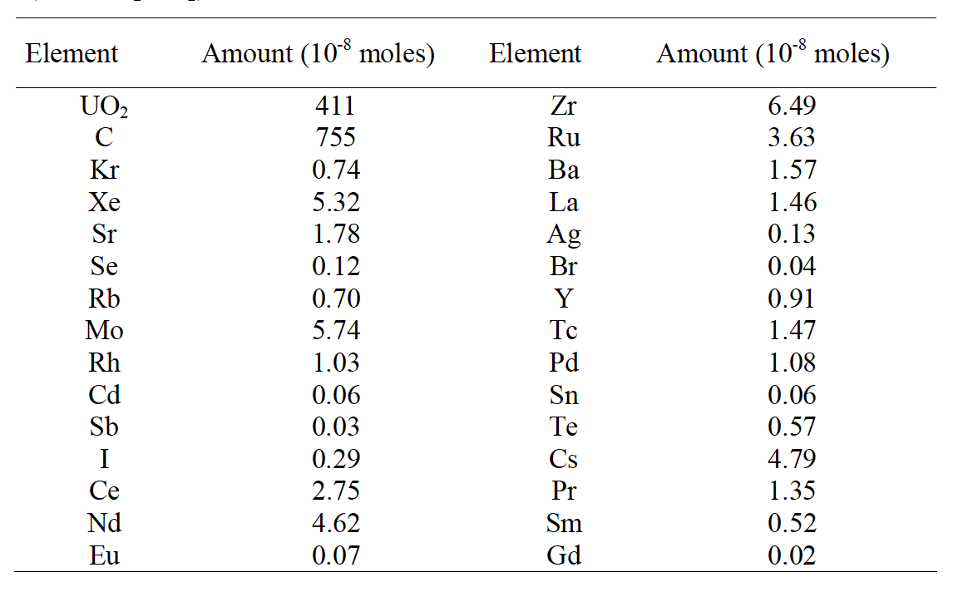
Fission Products
The rate of change of each nuclide is a function of three processes:
depletion of heavy nuclei by fission and corresponding production of lighter nuclei (fission products)
production by radioactive decay (actinides and fission products) and/or by neutron capture (actinides)
loss by radioactive decay (actinides and fission products) and/or by neutron capture (actinides)
Element inventory for a UO2 kernel @ 5.5% FIMA on the right

Slide 26
Fission Products
Fission products in UO2 are primarily located as substitutional atoms, commonly paired with additional vacancies
A large number of fission products are highly insoluble in UO2, including Xe, I, and Br
Some solubility exists for transition metals such as Zr and alkaline metals such as Sr, and high solubility exists for some rare earth elements, such as Ce
Fission products in the fuel lattice can diffuse out of the UO2 to grain boundaries
The diffusion mechanism depends on the nature of the fission product trap sites and on the fission product intrinsic characteristics
Irradiation effects can greatly enhance or reduce this diffusion by trapping mechanisms on extended

Slide 27
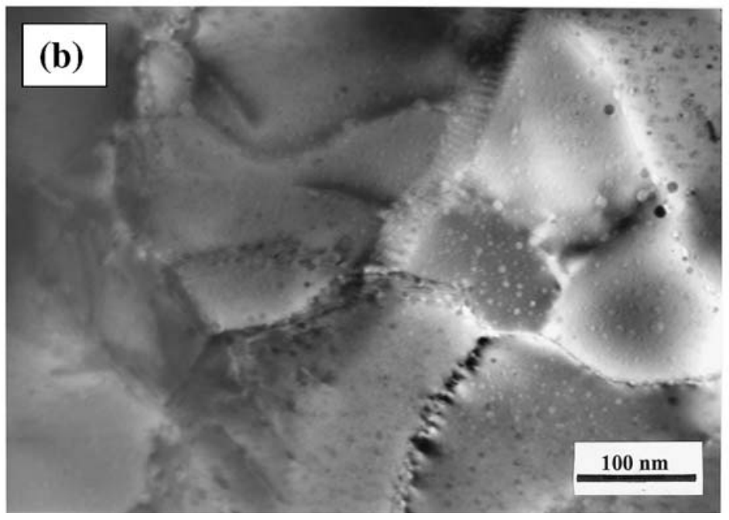
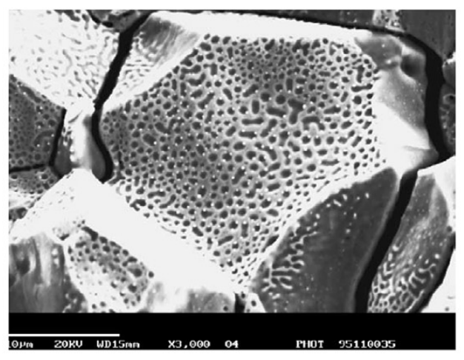
Fission Products
The fission gases precipitate primarily as intragranular bubbles which can grow by gas-atom and vacancy absorption
Fission gases can migrate to grain boundaries by atomic or bubble diffusion to form intergranular bubbles where they can grow by addition of gas and vacancies
Fission-rate and temperature help to strongly limit bubble size and maintain a substantial fission-gas atom population in the fuel lattice by re-solution of gas from bubbles
Once intergranular-bubble growth becomes significant causing interconnection of porosity, a path from within the kernel to the buffer is created leading to fission-gas release by a percolation mechanism

Slide 28
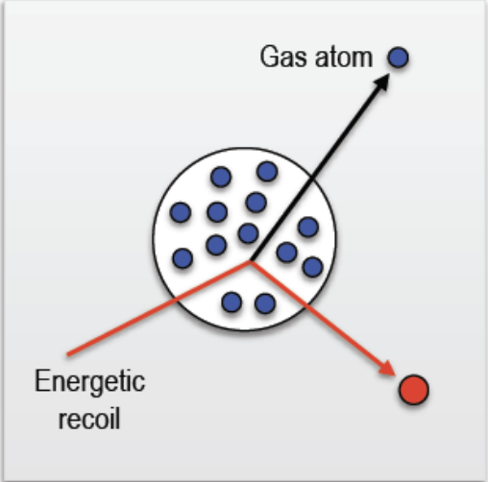
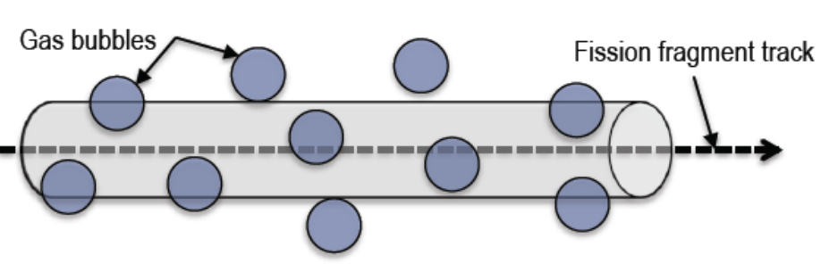
Bubble Resolution
Homogeneous resolution
individual gas atoms are ejected from the gas bubble through colliusions with energetic fission fragments or recoil uranium atoms
Heterogeneous resolution
bubble are almost completely destroyed by the passage of a fission fragment

Slide 29
Fission Product Chemistry
Rare earth elements have high solubility in UO2 and form rare earth oxides (REOs)
Zr, Nb and Sr have significant solubility in UO2 and oxidize to form ZrO2, Nb2O3 and SrO
Fission products that either have lower solubility or are less likely to form stable oxides, such as Ba, Te and Mo, diffuse to the grain boundaries and form perovskite or intermetallic precipitates
These grain boundary inclusions can allow for release from the fuel kernel
Ag and Pd are known to form intermetallic precipitates and are readily release from the fuel kernel

Slide 30
CO Pressurization
The result of CO and CO2 formation is internal pressurizing of the particle that increases with burnup and adds to the pressurization from fission gases
At lower burnup (≤ 6 % FIMA), pressurization of the particle arises principally from fission-gas release from the fuel kernel
At higher burnup (9% FIMA, at 1450 K), the pressure resulting from fission gases can represent half of the contribution of CO and CO2 in an HTGR TRISO coated particle
The suppression of excessive CO formation during oxidation of a UO2 based particle remains an important design objective at moderate and high burnup
The failure of the SiC layer may happen because of over-pressurization due to CO formation
CO and CO2 pressures are suspected of being partly responsible for the mechanical weakening of the IPyC coating, and corrosion of the SiC layer by CO can occur as a result from failure of the IPyC coating

Slide 31
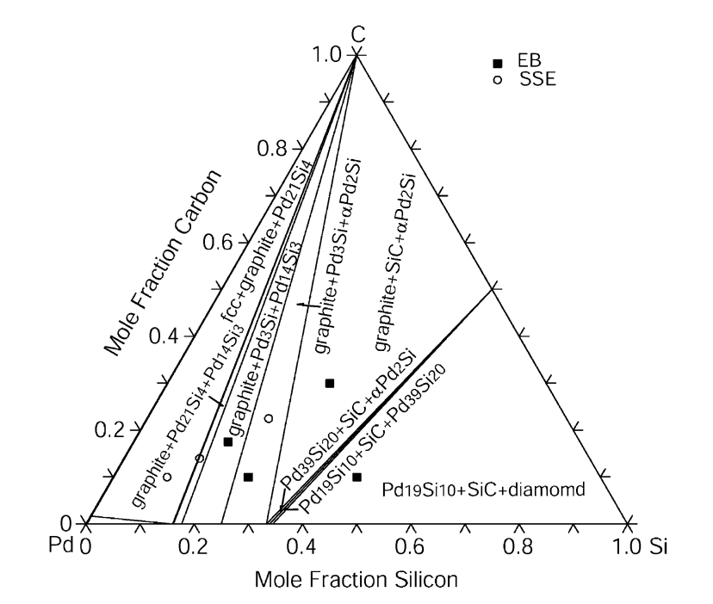
SiC Corrosion
The silicon carbide layer serves as a critical fission product barrier, but can be corroded by fission products, in particular palladium
Additionally silver can be transported through intact SiC layers
For Pd, the reaction with SiC can be qualitatively explained by the phase-diagram, where a number of intermetallic structures are present

Slide 32
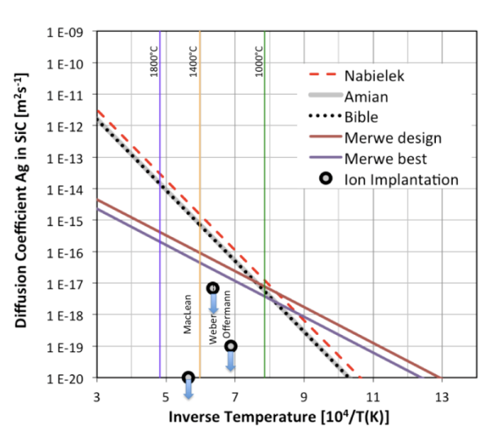
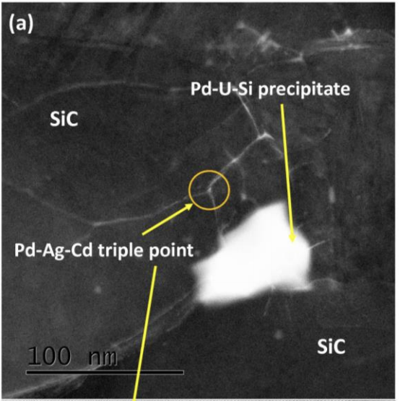
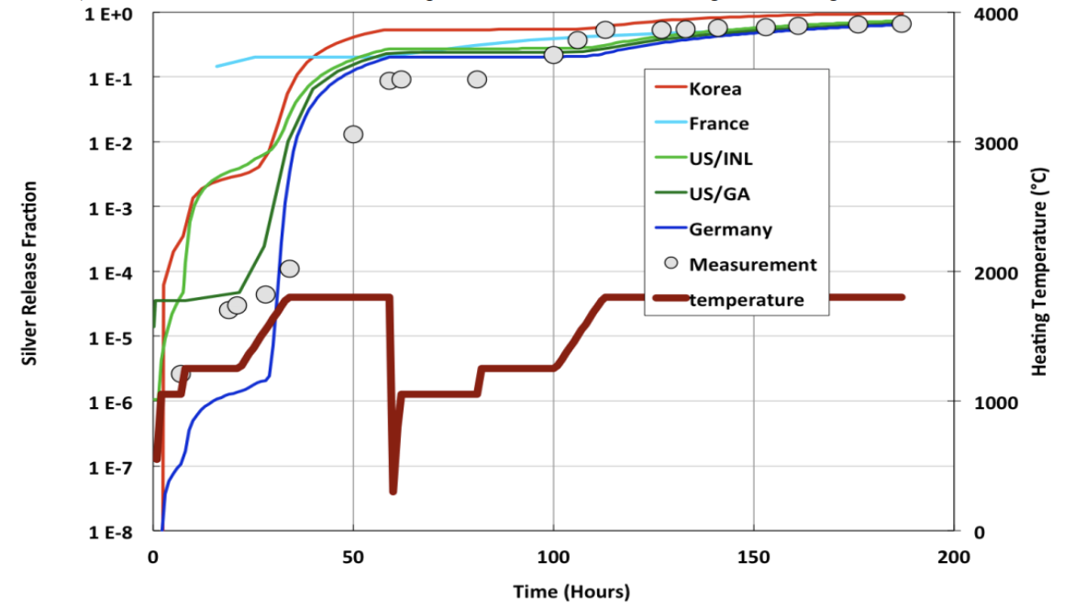
SiC Corrosion
Silver release has been observed from undamaged particles suggesting that Ag migrates through intact SiC layers at temperatures >1100 C
The Ag migration mechanism remains not fully understood, but is still an active area of research
Ag release has a temperature dependence, pointing towards a diffusive mechanism
From microstructural analyses, it seems possible that Ag, Cd and Pd cluster and transport together at grain boundaries and triple points because of their common chemical properties

Slide 33
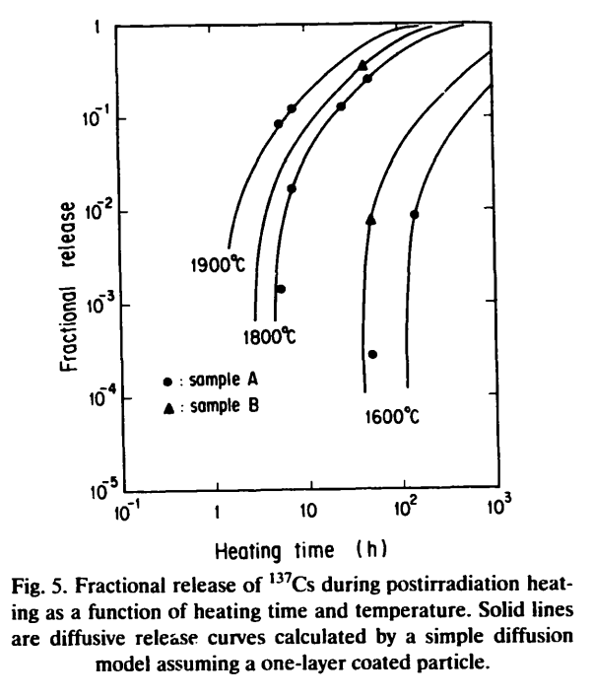
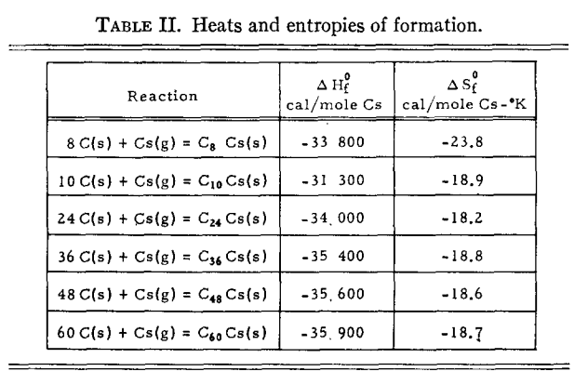
SiC Corrosion
Once cesium has migrated into the buffer, it can react with carbon
At nominal temperatures, cesium may be released and associated with carbon of the buffer layer to form compounds
These compounds, if they are not stable with increasing temperatures, may become a potential source of cesium release

Slide 34
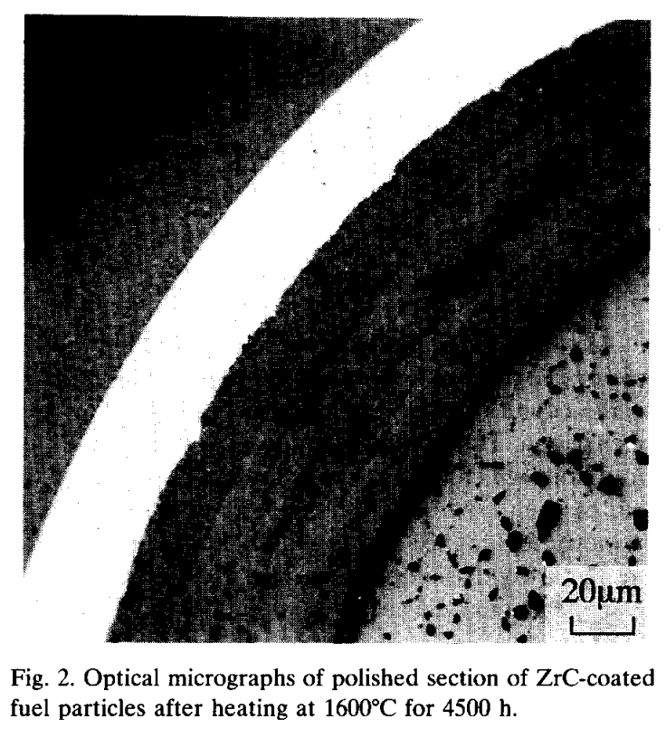
Si vs ZrC Corrosion
To prevent corrosion by Pd, new combinations of coating layers have been proposed
An alternative approach consists of replacing the SiC coating by a ZrC layer
Experimental observations showed neither Pd attack nor thermal degradation of ZrC up to 1600C
ZrC was also shown to have a high capacity to retain Cs, but poor retention of Ru
At higher T, the deterioration of the ZrC particle is caused by failure of the IPyC
The development of TRISO with ZrC-coating is at an early stage compared to the SiC-coated design

Slide 35
UCO Fission Product Behavior
Rare earths are released more easily/rapidly with an increasing content of UC2, as trapping occurs in the UO2 lattice
Oxygen liberated during the fission process of UO2, first oxidizes the carbide UC2 phase and then the RE fission products because of their high affinity for oxygen
The fission product elements with lower affinity for oxygen (Sr, Eu, Zr, Ba) exist as carbide compounds
As the burnup increases, the UC2 phase in the kernel decreases
When UC2 has fully disappeared, the oxygen potential then increases and oxygen is available to form oxide compounds with these fission products

Slide 36
TRISO Stresses
The irradiation causes the kernel to swell and the buffer layer to shrink, thereby modifying the internal void volume available to the fission and reaction gases
The porosity of the buffer results in the only force impinging on the three load bearing layers being the gas pressure on this surface
If the IPyC and OPyC were absent, the gases produced in the fission process would simply stress the SiC layer and, if the pressure were high enough, cause it to fail
However, these tangential stresses are reduced by the presence of the two PyC layers because; under unrestrained conditions they would shrink during irradiation

Slide 37
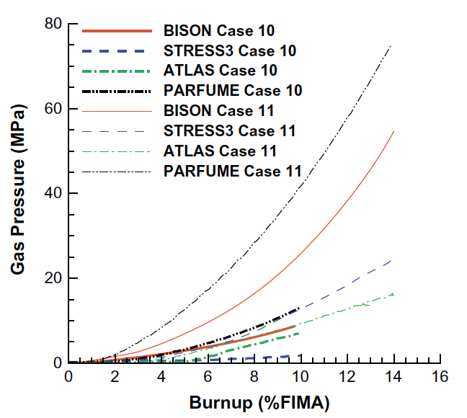
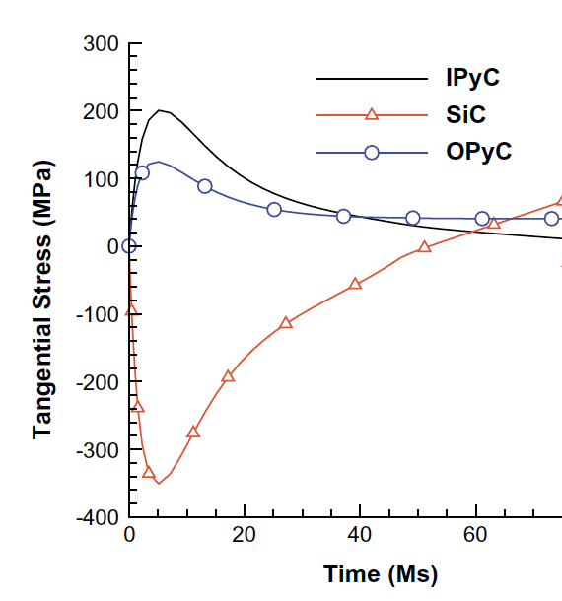
TRISO Stresses
PyC shrinkage will be largely restrained by the SiC layer, and tangential stresses will be generated in both PyC layers and radial, inward acting forces imposed on the two surfaces of the SiC layer
In practice, these tangential stresses in the two PyC layers will attain a quasi-equilibrium stress state because their shrinkage is counter-balanced by irradiation creep
The SiC elastic modulus is at least an order of magnitude greater than that of PyC and thus, the dimensional changes and creep strains of SiC are comparatively much smaller than for PyC

Slide 38
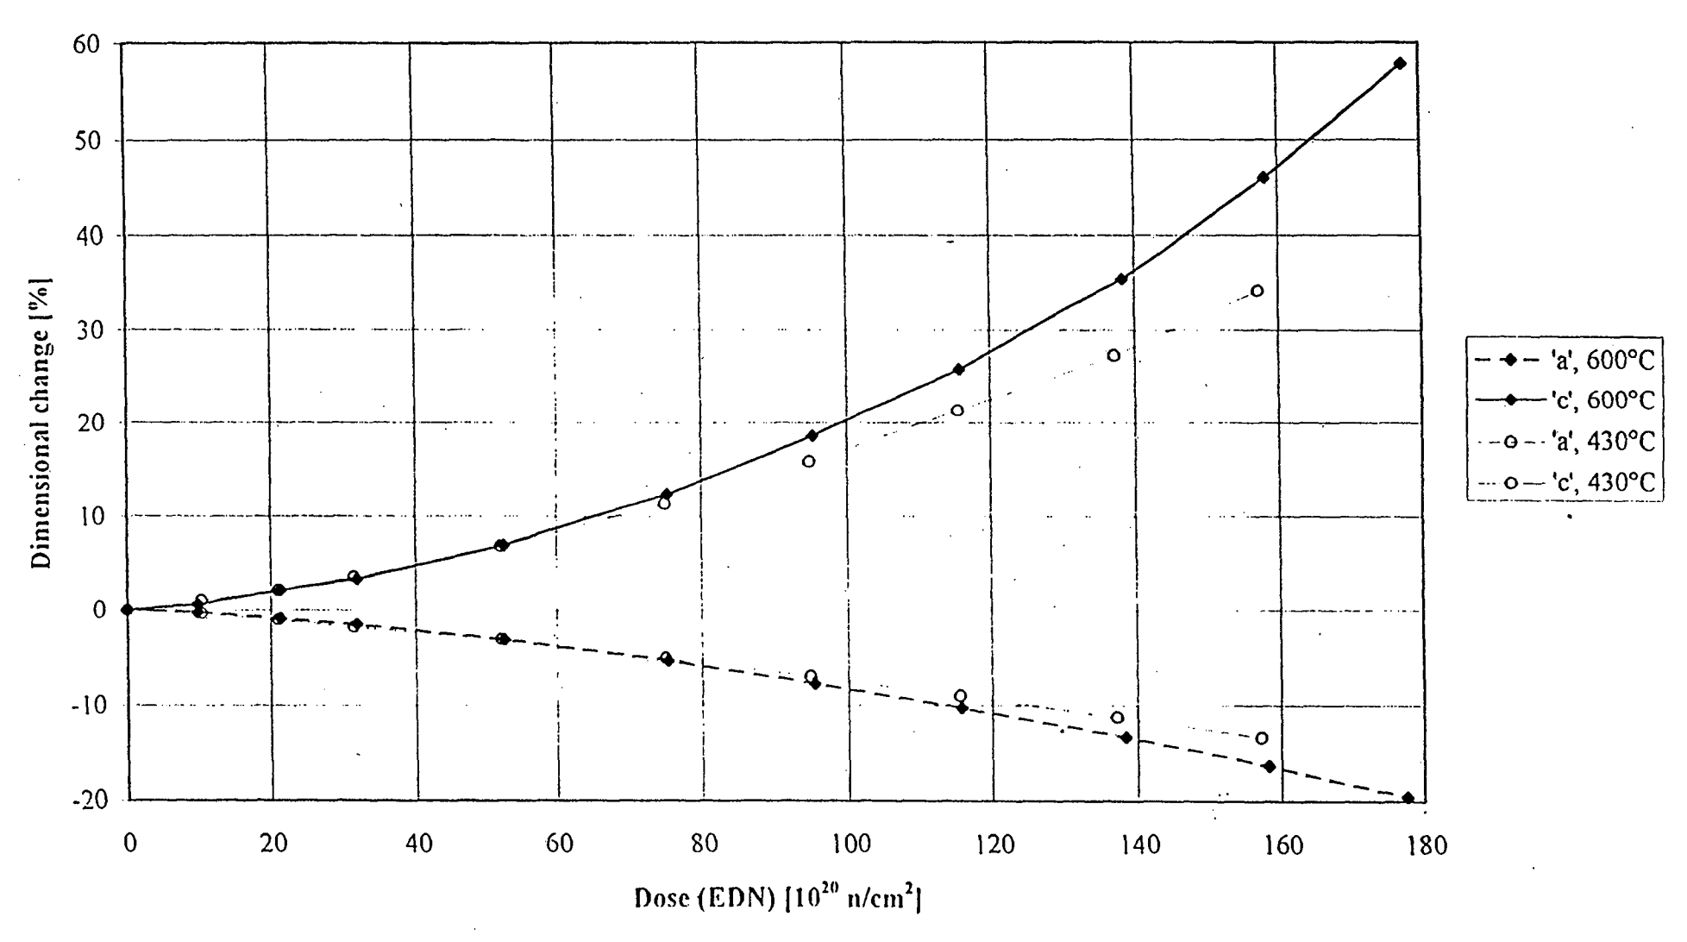
Graphite Evolution
During operation the graphite properties, including strength, modulus, coefficient of thermal expansion, and thermal conductivity, change with fluence
Significant dose and temperature gradients can lead to the generation of internal stresses; however, irradiation creep relieves these stresses
Dimensional changes arise due to the formation of interstitial and vacancy loops within the graphite basal planes
The formation of these loops causes 'c' axis expansion and 'a' axis contraction, the magnitude of which is a function of fast neutron dose and irradiation temperature

Slide 39
Graphite Shrinkage
Due to the manufacturing process of nuclear graphite, the graphite component has a much lower density than may be expected (1.7-1.9 g/cm3) compared with 2.2.6 g/cm3 for pure graphite crystals

Slide 40
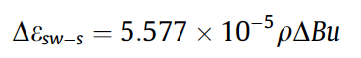
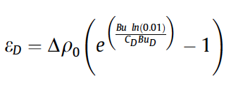
Fuel Kernel Swelling
Solid fission product swelling
Gaseous fission product swelling
Densification
Fission gas release
CO production

Slide 41
Questions?

